Slide 1

Wireless Networking
Ambuj Varshney
ambujv@nus.edu.sg
Notes:
++ Thank you for inviting me to give this talk
++ In this talk, I will present a pathway that can enable us to make wireless embedded systems ubiquitous. I will describe my previous research efforts that tackle the critical challenges that limit the growth of wireless embedded systems. These are related to the growing energy asymmetry that exists between sensing, computation and communication blocks on these platforms.
++ Finally, I will conclude my talk by covering the research agenda that I would like to work on as a faculty member.

Slide 2
Roadmap of the lecture today
General course information and updates
Let us review what we had covered in the last lecture
Terminology used: What is radio? Electromagnetic waves?
Basics of modulation and antennas
Signal propagation, estimating communication range
Notes:
Here is the roadmap of the major topics that I am going to cover during the presentation. We have already covered the exponential growth of the internet of things; next, I will talk about the critical energy challenge that can severely hinder this massive growth and preventing us from realising this immense economic value enabled by the IoT.

Slide 3
Wireless Signal Propagation, Modulation, Estimating Range
Notes:
++ Over the past few years, I have designed several backscatter and beyond backscatter systems that precisely overcome these critical challenges that have limited the widespread deployment of backscatter on IoT devices.
++ The research vision that I have pursued and would like to pursue as a faculty member is to enable a massive deployment of IoT devices by bridging the energy asymmetry between sensing, computation and communication blocks by designing novel platforms and communication mechanisms. I am going to describe some of my research contributions next.

Slide 4
Administration and Course Logistics
Notes:
++ Over the past few years, I have designed several backscatter and beyond backscatter systems that precisely overcome these critical challenges that have limited the widespread deployment of backscatter on IoT devices.
++ The research vision that I have pursued and would like to pursue as a faculty member is to enable a massive deployment of IoT devices by bridging the energy asymmetry between sensing, computation and communication blocks by designing novel platforms and communication mechanisms. I am going to describe some of my research contributions next.

Slide 5
General information regarding the course
Course code: 4222/5422, Day of week: Friday, 6:30 to 8:30 pm (Lectures)
Tutorials: Next Week! Seven slots. If you still have issues, please email me
Piazza: You should have received email to join.
Office hours: COM3 - #2 – 25, Thursday : 4 – 6 pm (by appointment)
Send me an email to reserve slot. We can discuss absolutely anything!
Notes:
++ We may all have heard of the term Internet of Things. So how are these wireless embedded systems related to the Internet of Things: Today, IoT includes a broad class of devices, including powerful platforms such as smartphones. However, it also includes more resource-constrained devices and what we call Wireless Embedded Systems, and in fact, I consider it to be one of the essential parts of the IoT ecosystem.
++ These are platforms equipped with a radio transceiver, sensor, microcontroller, and some form of energy storage. These platforms also often form a network, and sensor network as it is called has been an active area of research for the past two decades.
++ The research community has also developed wireless embedded platforms which we may know about, and these include: CMUCAM, which is an image sensor platform developed at Carnegie Mellon University, or Permamote is long life sensor platform from the lab I am associated with at UC Berkeley or Lorea which is a long-range backscatter platform that I had developed as part of my doctoral dissertation at Uppsala University. All of these are an example of Wireless Embedded Systems.

Slide 6

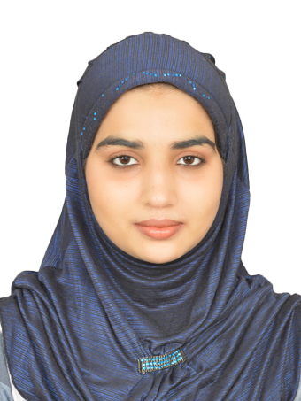

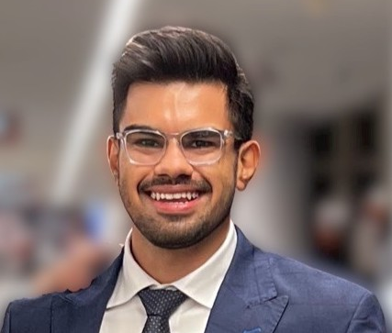

Brilliant teaching assistants of the course
Tutorials: They are starting next week
Malaika Afra Taj (PhD Student, SoC)
Kanav Sabharwal (PhD Student, SoC)
Ayanga Kalupahana (PhD Student SoC)
Rajashekar Chinthalapani (PhD Student SoC)
Pramuka Medaranga (PhD Student SoC)
Notes:
++ We may all have heard of the term Internet of Things. So how are these wireless embedded systems related to the Internet of Things: Today, IoT includes a broad class of devices, including powerful platforms such as smartphones. However, it also includes more resource-constrained devices and what we call Wireless Embedded Systems, and in fact, I consider it to be one of the essential parts of the IoT ecosystem.
++ These are platforms equipped with a radio transceiver, sensor, microcontroller, and some form of energy storage. These platforms also often form a network, and sensor network as it is called has been an active area of research for the past two decades.
++ The research community has also developed wireless embedded platforms which we may know about, and these include: CMUCAM, which is an image sensor platform developed at Carnegie Mellon University, or Permamote is long life sensor platform from the lab I am associated with at UC Berkeley or Lorea which is a long-range backscatter platform that I had developed as part of my doctoral dissertation at Uppsala University. All of these are an example of Wireless Embedded Systems.

Slide 7
Course webpage and lecture recordings
Course webpage: https://weiserlab.github.io/wirelessnetworking/
Canvas: It will be used for submission of project/assignment
Piazza: A forum for discussions. It is already active
Look out for emails with subject (CS4222) for the announcements
How about lecture videos?
First lecture video is already available on the canvas
Last years lecture video are already linked to the course page
Caution: Some parts of the course have undergone change. Prior years lecture may cover additional material or material not planned this year
Notes:
++ We may all have heard of the term Internet of Things. So how are these wireless embedded systems related to the Internet of Things: Today, IoT includes a broad class of devices, including powerful platforms such as smartphones. However, it also includes more resource-constrained devices and what we call Wireless Embedded Systems, and in fact, I consider it to be one of the essential parts of the IoT ecosystem.
++ These are platforms equipped with a radio transceiver, sensor, microcontroller, and some form of energy storage. These platforms also often form a network, and sensor network as it is called has been an active area of research for the past two decades.
++ The research community has also developed wireless embedded platforms which we may know about, and these include: CMUCAM, which is an image sensor platform developed at Carnegie Mellon University, or Permamote is long life sensor platform from the lab I am associated with at UC Berkeley or Lorea which is a long-range backscatter platform that I had developed as part of my doctoral dissertation at Uppsala University. All of these are an example of Wireless Embedded Systems.

Slide 8
How would the student’s performance be graded
Component | Weightage to Overall Grade
Project (group) | 20 %
Assignment 1 (group) | 5 %
Assignment 2 (group) | 10 %
Assignment 3 (group) | 15 %
Tutorial | 10 %
Final assessment | 40 %

Slide 9
Important Events and Deadlines
Event | Date
Lectures | Starting Week 1 (19th January)
Group formation and notification | End of Week 4
Tutorials | Begin Week 3 (29th January)
Assignment 1 | Demonstrate to TA’s Week 5
Assignment 2, 3 | TBA
Project submission | 26th April 2024 (EOD)
Final assessment | 29th April 2024

Slide 10
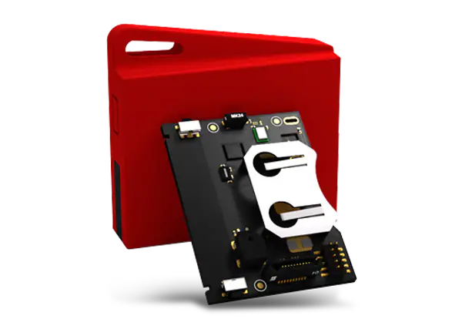
Collection of sensor tags and group formation
Sensor tag and Programmer: A wireless embedded device
Look for email for information regarding collection of Sensortags next week
We can give 2-3 sensor tags per group
Inform: Malaika for group formation. Look for details on mail.
Can start working with sensor tags already (if you have formed group)
Notes:
++ We may all have heard of the term Internet of Things. So how are these wireless embedded systems related to the Internet of Things: Today, IoT includes a broad class of devices, including powerful platforms such as smartphones. However, it also includes more resource-constrained devices and what we call Wireless Embedded Systems, and in fact, I consider it to be one of the essential parts of the IoT ecosystem.
++ These are platforms equipped with a radio transceiver, sensor, microcontroller, and some form of energy storage. These platforms also often form a network, and sensor network as it is called has been an active area of research for the past two decades.
++ The research community has also developed wireless embedded platforms which we may know about, and these include: CMUCAM, which is an image sensor platform developed at Carnegie Mellon University, or Permamote is long life sensor platform from the lab I am associated with at UC Berkeley or Lorea which is a long-range backscatter platform that I had developed as part of my doctoral dissertation at Uppsala University. All of these are an example of Wireless Embedded Systems.

Slide 11
Roadmap of the lecture today
General course information and updates
Let us review what we had covered in the last lecture
Terminology used: What is radio? Electromagnetic waves?
Basics of modulation and antennas
Signal propagation, estimating communication range
Notes:
Here is the roadmap of the major topics that I am going to cover during the presentation. We have already covered the exponential growth of the internet of things; next, I will talk about the critical energy challenge that can severely hinder this massive growth and preventing us from realising this immense economic value enabled by the IoT.

Slide 12
Let us recall what we covered in last lecture
Notes:
++ Over the past few years, I have designed several backscatter and beyond backscatter systems that precisely overcome these critical challenges that have limited the widespread deployment of backscatter on IoT devices.
++ The research vision that I have pursued and would like to pursue as a faculty member is to enable a massive deployment of IoT devices by bridging the energy asymmetry between sensing, computation and communication blocks by designing novel platforms and communication mechanisms. I am going to describe some of my research contributions next.

Slide 13
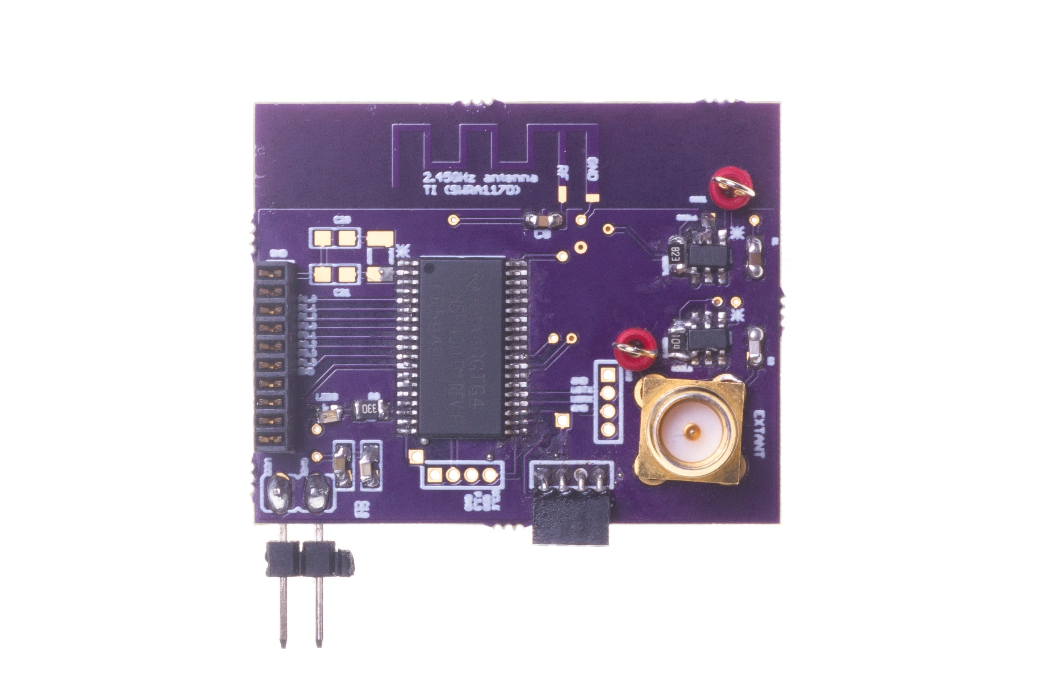
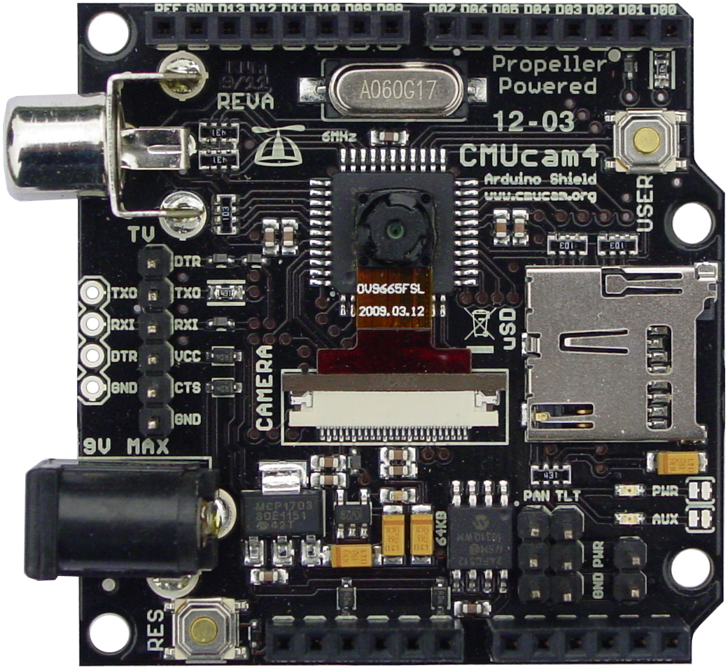
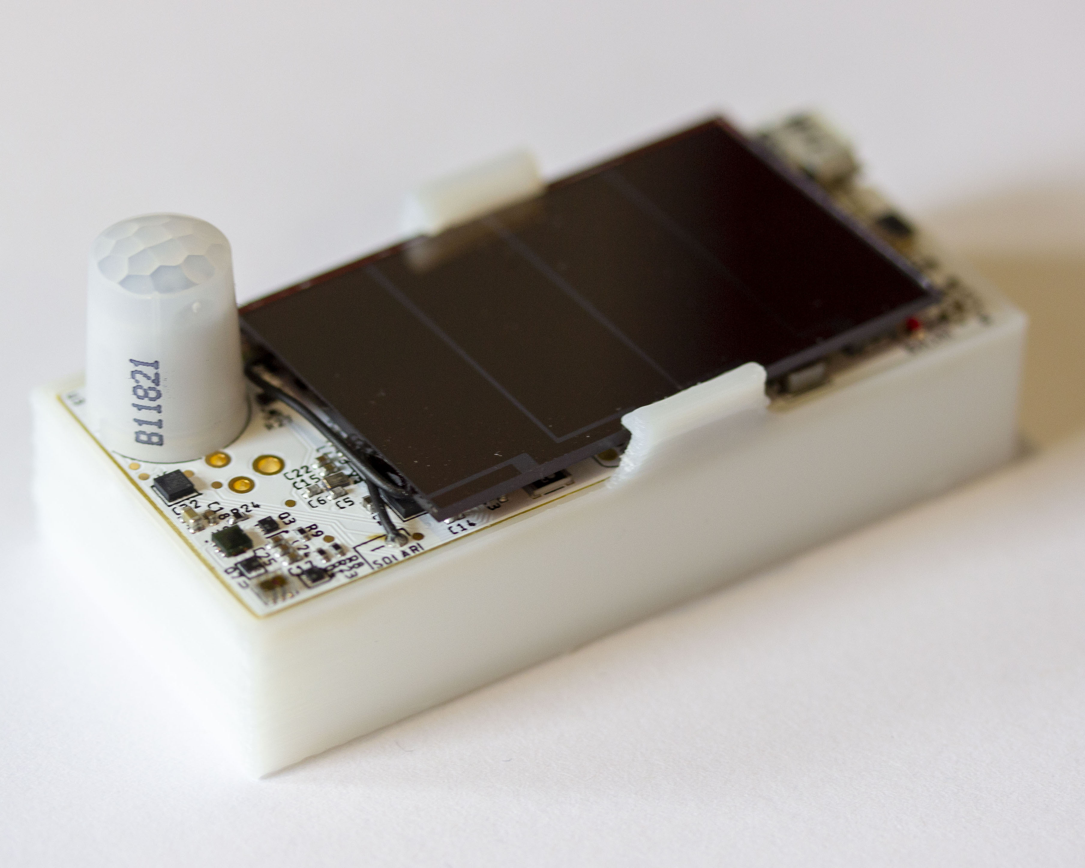
Internet of things and wireless embedded systems
Wireless embedded systems (WES) are platforms equipped with radio transceiver, sensors, microcontroller and some form of energy storage
WES are an important part of the internet of things (IoT) ecosystem
CMUCam
[Carnegie Mellon University]
Permamote
[University of California, Berkeley]
LoRea
[Uppsala University]
Notes:
++ We may all have heard of the term Internet of Things. So how are these wireless embedded systems related to the Internet of Things: Today, IoT includes a broad class of devices, including powerful platforms such as smartphones. However, it also includes more resource-constrained devices and what we call Wireless Embedded Systems, and in fact, I consider it to be one of the essential parts of the IoT ecosystem.
++ These are platforms equipped with a radio transceiver, sensor, microcontroller, and some form of energy storage. These platforms also often form a network, and sensor network as it is called has been an active area of research for the past two decades.
++ The research community has also developed wireless embedded platforms which we may know about, and these include: CMUCAM, which is an image sensor platform developed at Carnegie Mellon University, or Permamote is long life sensor platform from the lab I am associated with at UC Berkeley or Lorea which is a long-range backscatter platform that I had developed as part of my doctoral dissertation at Uppsala University. All of these are an example of Wireless Embedded Systems.

Slide 14
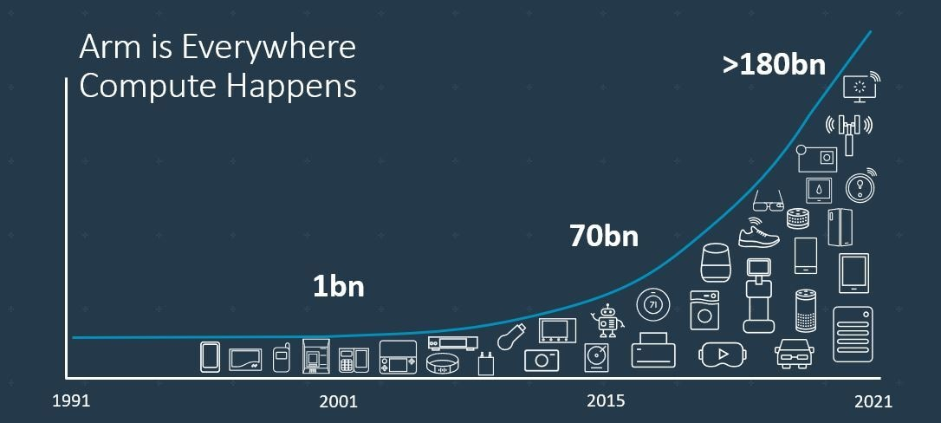
Trillion embedded devices will be deployed soon
Fourth quarter of 2020. Arm shipped 4.4 billion Cortex-M processors
ARM Press Release (Feb 11, 2021) reporting on Fourth Quarter 2020
Notes:
++ Due to the numerous applications that the internet of things enables, we are witnessing a massive growth in the number of microcontrollers being sold. These microcontrollers form the heart of the IoT platforms.
++ To illustrate this point: ARM, a popular UK based company, just reported numbers, and in these numbers, they state that they sold 4.4 billion cortex M processors in just one quarter. These microcontrollers are almost exclusively used on IoT platforms, which demonstrates the massive growth we are witnessing in the number of deployed IoT devices.
++ If this growth continues, and in fact, I believe this growth will accelerate, we will soon have a trillion embedded devices that are going to be deployed in the world.

Slide 15
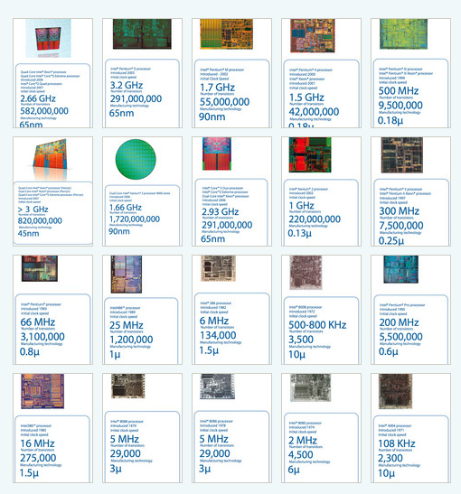
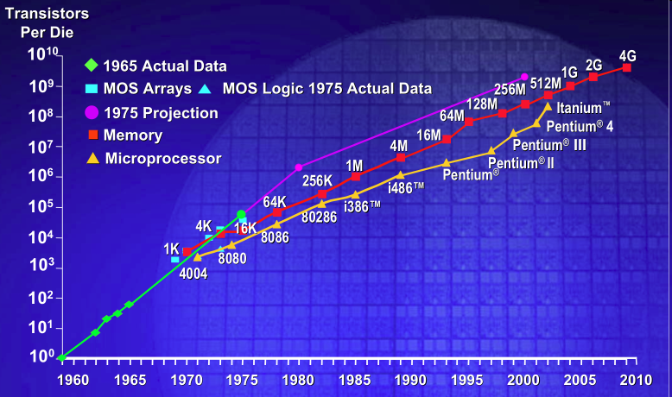
IC transistor count doubles every two years
Photo Credit: Intel
Notes:
So if we look at the computing spectrum today, each of the classes exist simultaneously. In a room we can put 100s of teraflops and many petabytes of computing.
Our productivity, document preparation, and personal information management fits in our pocket and a new class is emerging that will provide a means of streaming information to and from the physical world like we have never seen before.

Slide 16
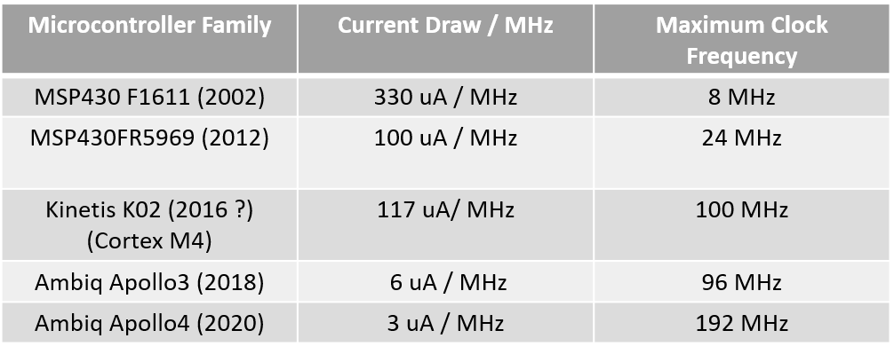
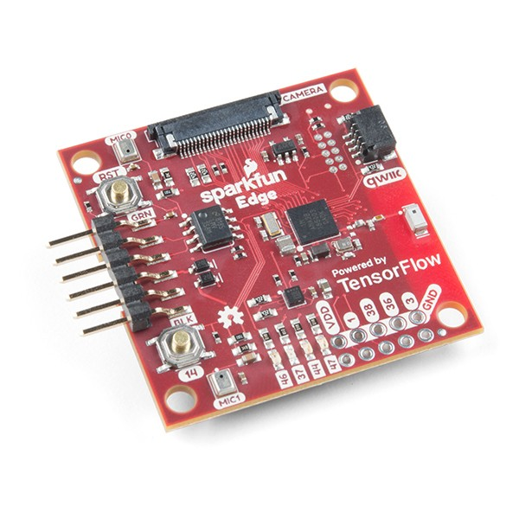
Computation is becoming energy inexpensive
Today, computation is at least an order of magnitude more energy expensive than performing a sensing operation
Digital components are becoming energy efficient (Moore’s law)
We can expect power consumption for computation to match sensing
Ambiq Apollo3
Notes:
First, we look at the computational elements, and these consist of a microcontroller or an FPGA. Today, we find that these computational elements consume at least one order of magnitude higher power consumption when compared to the commonly used sensors.
However, we also find that microcontrollers are increasingly becoming energy efficient. We investigate a typical microcontroller that has been used in sensor platforms over the past two decades. We find that energy efficiency has improved by almost two orders of magnitude. Some of the present-generation microcontrollers, such as Ambiq Apollo4 consume just 3 uA/MHz than 330 uA for MSP430 used on platforms such as TelOS B.
If the trend continues, we can expect the microcontrollers to catch up with the sensors and become energy-efficient. This significant improvement is that the digital components are increasing becoming efficient as they follow moore’s law.

Slide 17
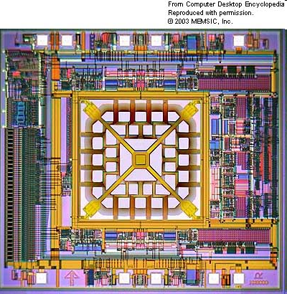
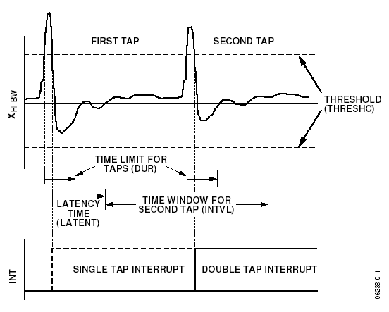
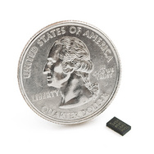
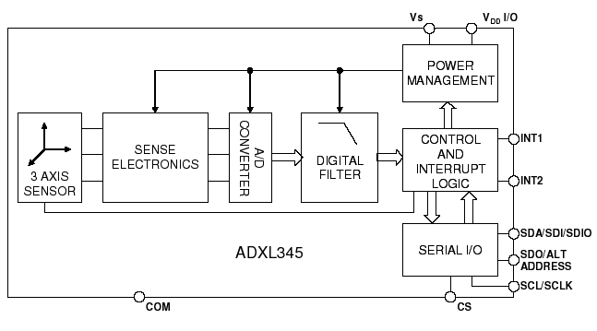
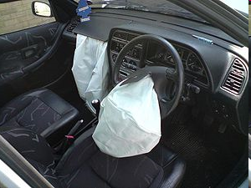
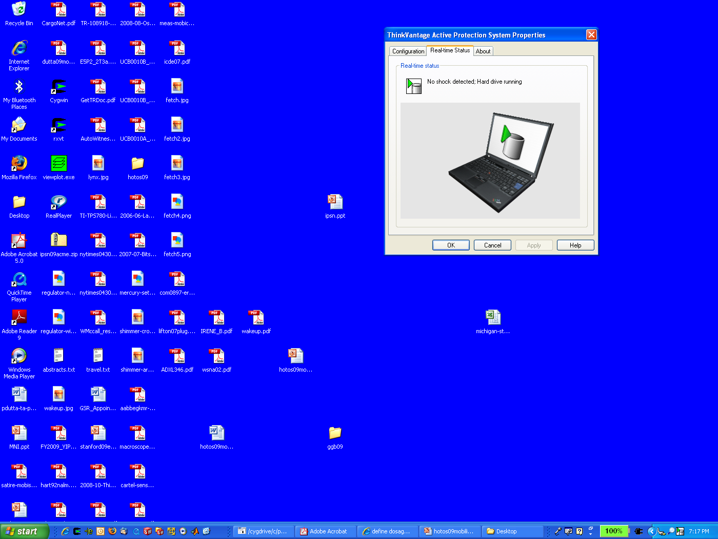
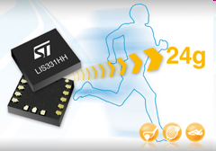
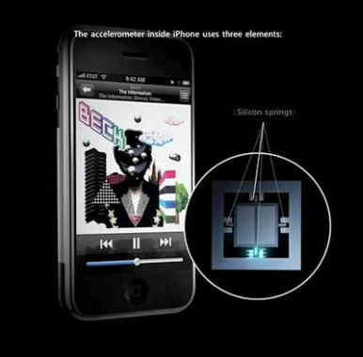
MEMS Accelerometers: Rapidly falling price and power
O(mA)
Price
Power
25 µA @ 25 Hz
ADXL345
[Analog Devices, 2009]
10 µA @ 10 Hz @ 6 bits
[ST Microelectronics, annc. 2009]

Slide 18
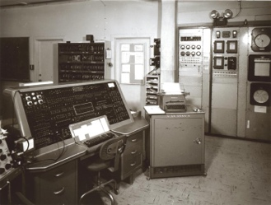
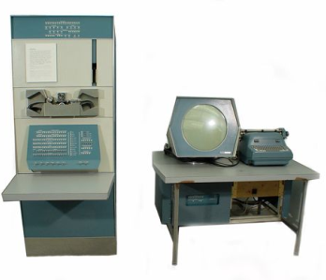
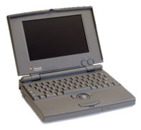
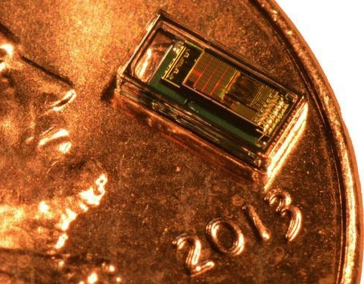
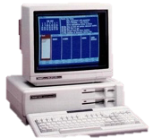

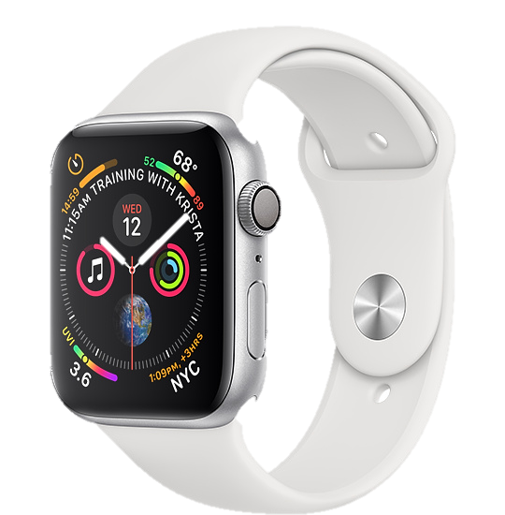
Trillion embedded devices will be deployed soon
Mainframe
“Roughly every decade a new, lower priced computer class forms based on a new programming platform, network, and interface resulting in new usage and the establishment of a new industry.”
1 per Enterprise
Workstation
1 per Engineer
[Bell et al. Computer, 1972, ACM, 2008]
Smart Dust
Laptop
100 – 1000’s per person
log (people per computer)
1 per Professional
IoT/Wearable
Mini Computer
10’s per person
1 per Company
Personal Computer
1 per Family
Smartphone
1 per person

Slide 19
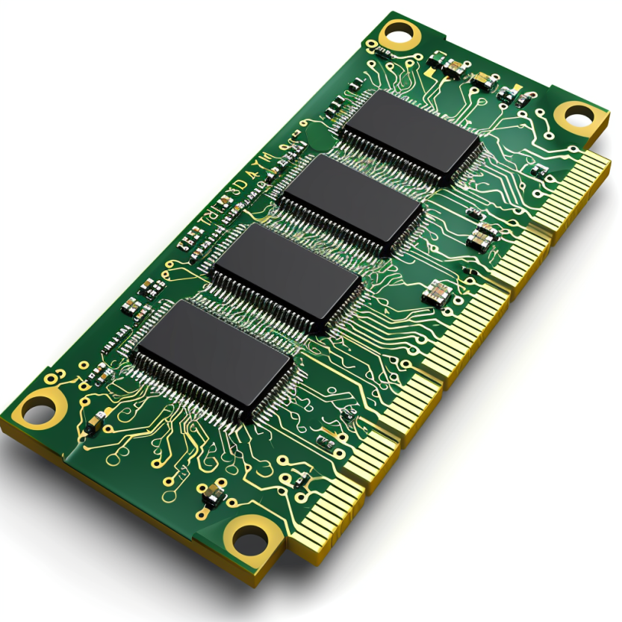
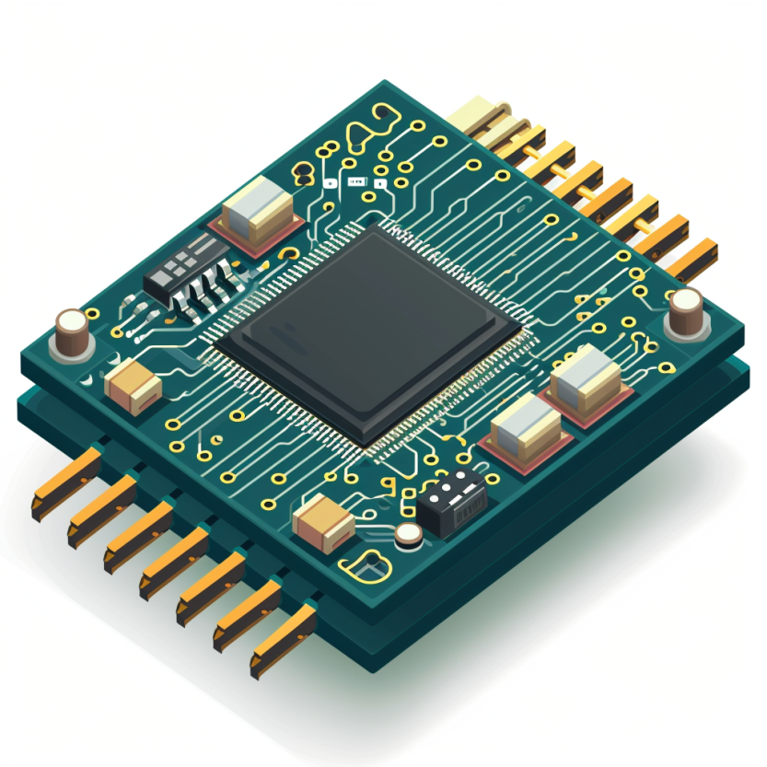

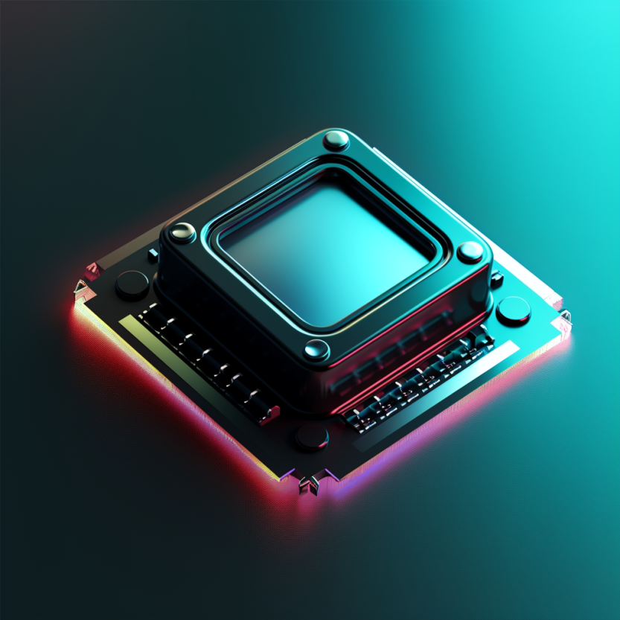

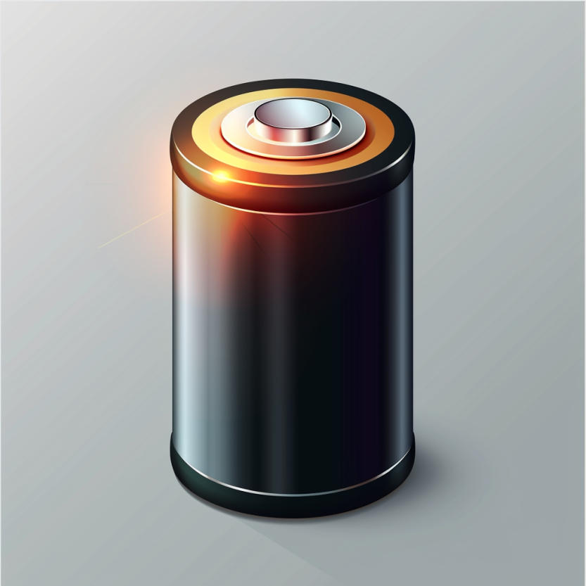
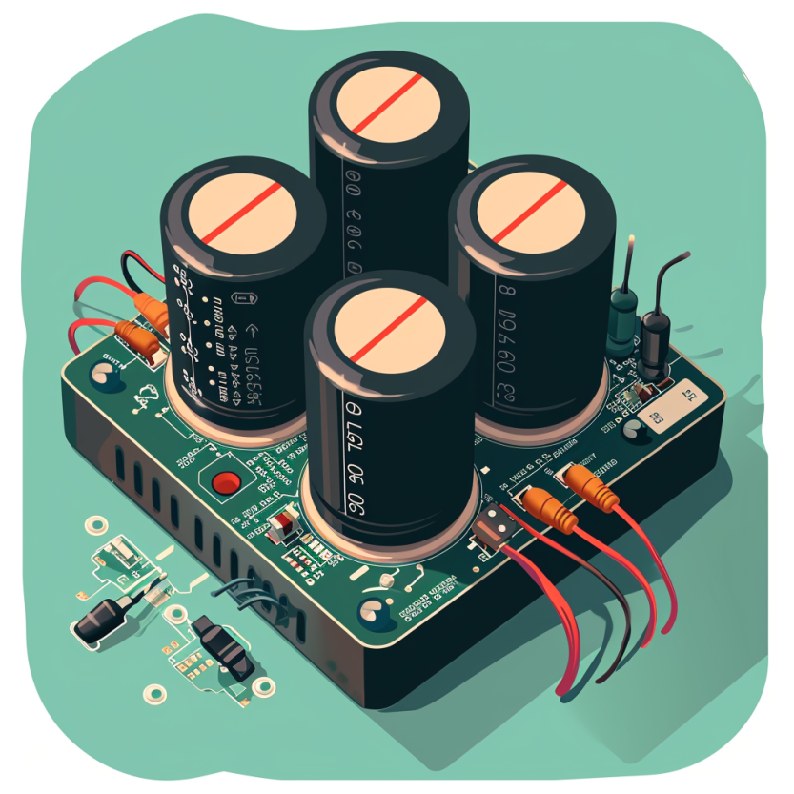
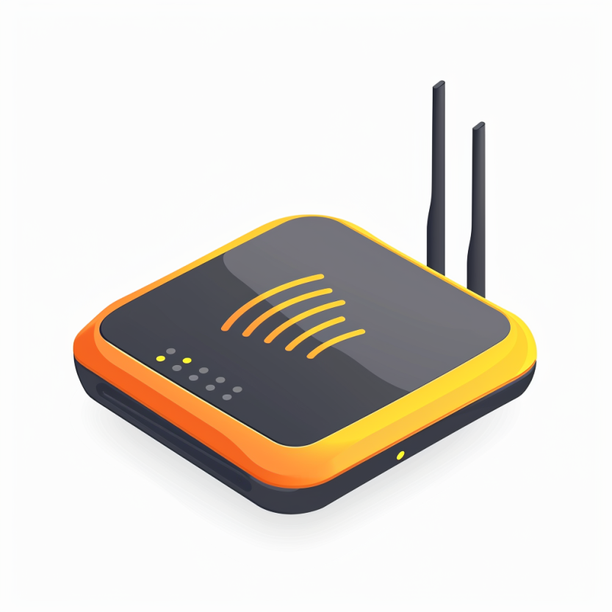

Four main tasks performed by an embedded device
Computation and Storage
Sensing and Actuation
Power
Management
Wireless Networking
Notes:
First, we look at the computational elements, and these consist of a microcontroller or an FPGA. Today, we find that these computational elements consume at least one order of magnitude higher power consumption when compared to the commonly used sensors.
However, we also find that microcontrollers are increasingly becoming energy efficient. We investigate a typical microcontroller that has been used in sensor platforms over the past two decades. We find that energy efficiency has improved by almost two orders of magnitude. Some of the present-generation microcontrollers, such as Ambiq Apollo4 consume just 3 uA/MHz than 330 uA for MSP430 used on platforms such as TelOS B.
If the trend continues, we can expect the microcontrollers to catch up with the sensors and become energy-efficient. This significant improvement is that the digital components are increasing becoming efficient as they follow moore’s law.

Slide 20
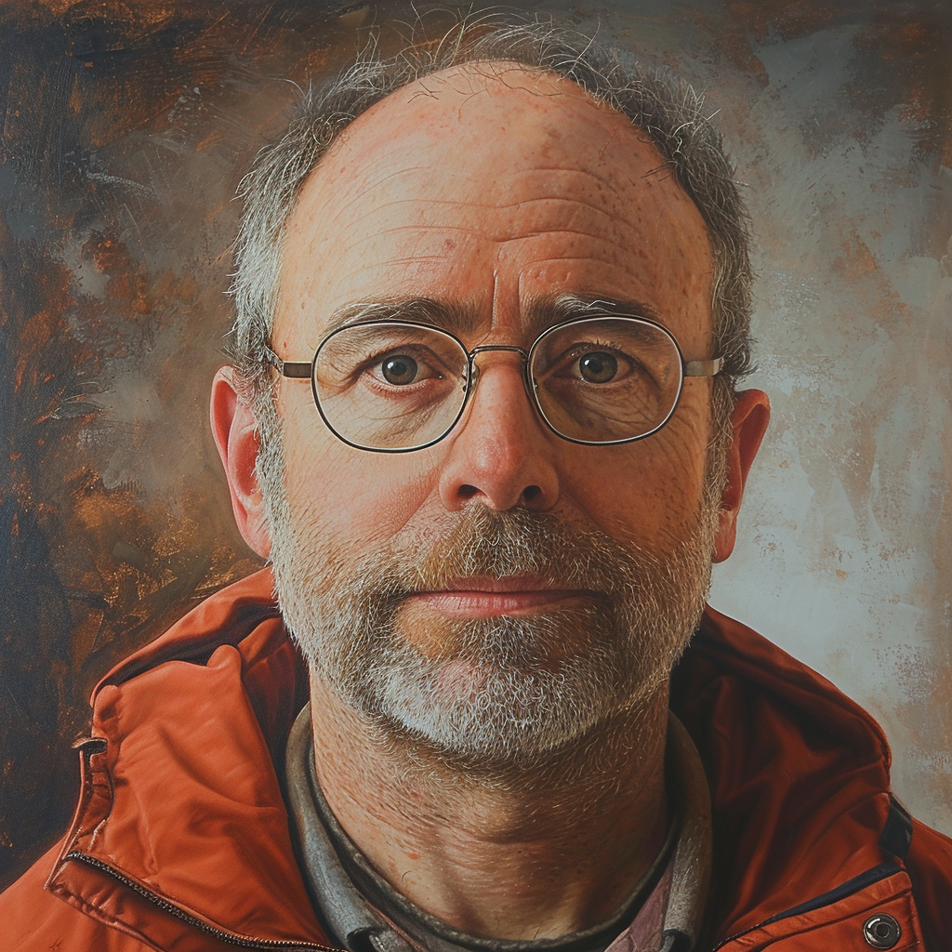
Mark Weiser vision of ubiquitous computing
Mark Weiser (1952 – 1999)
PhD (University of Michigan), CTO at Xerox PARC
Considered “Father” of ubiquitous computing
He is a highly influential figure in the area
What is ubiquitous computing?

Slide 21
Mark Weiser vision of ubiquitous computing
“Ubiquitous computing names the third wave in computing, just now beginning. First were mainframes, each shared by lots of people. Now we are in the personal computing era, person and machine staring uneasily at each other across the desktop. Next comes ubiquitous computing, or the age of calm technology, when technology recedes into the background of our lives.”

Slide 22
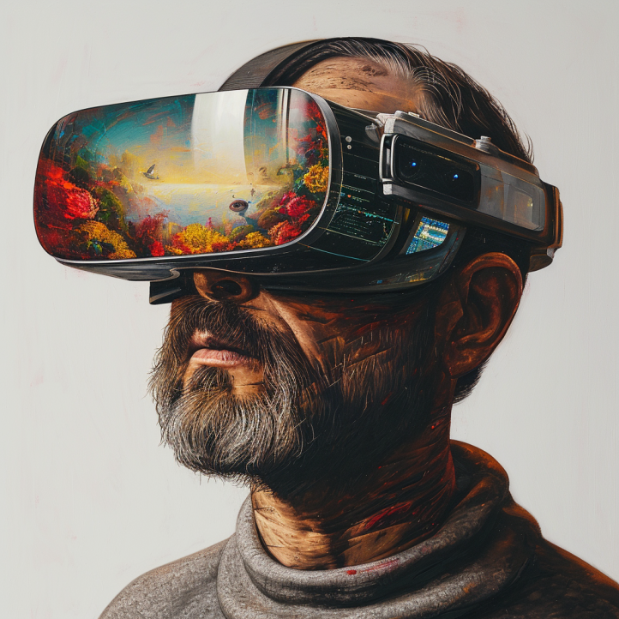
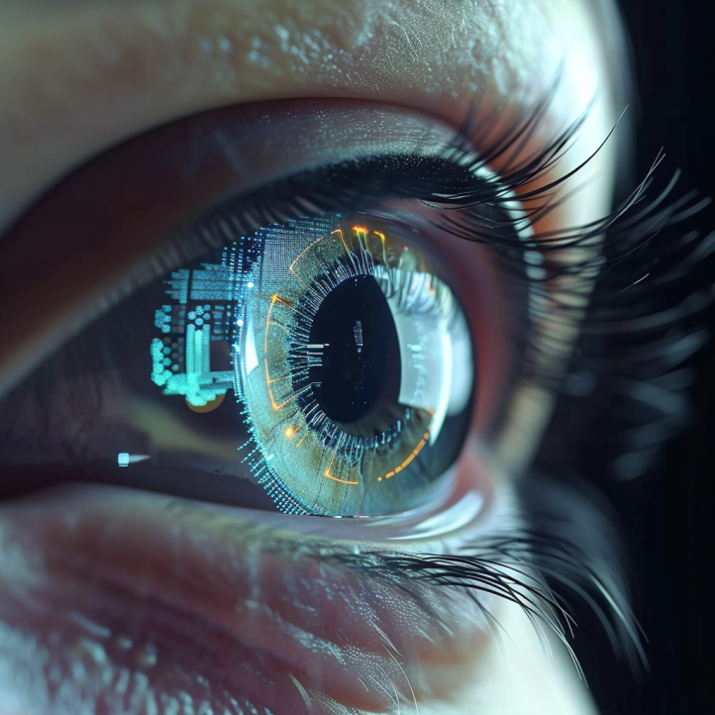
Mark Weiser vision of ubiquitous computing
What are upcoming technologies that may become ubiquitous?

Slide 23

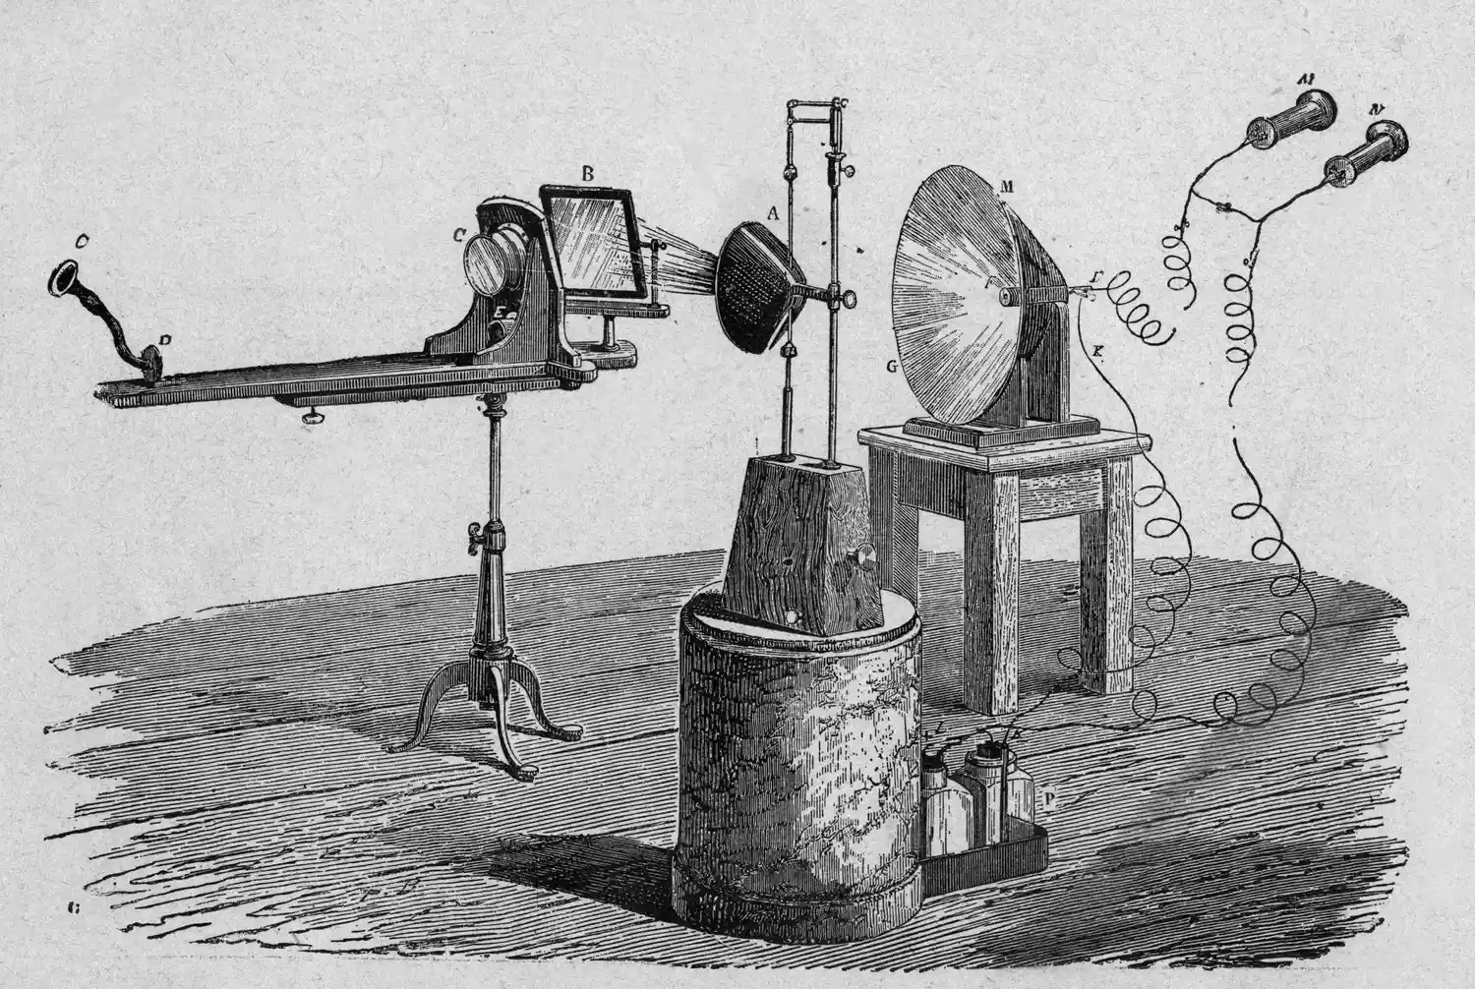
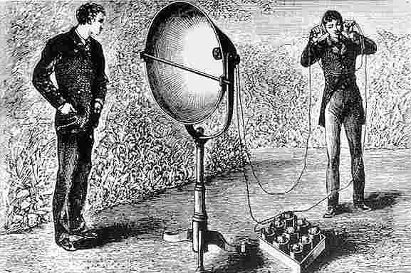
History of Wireless Transmissions
First to demonstrate wireless communication ?
1880: Alexander Graham Bell and his assistant Charles Sumner Tainter at the Bell Labs invented the photophone
Photophone: a device that transmitted sound on a beam of light
Notes:
First, we look at the computational elements, and these consist of a microcontroller or an FPGA. Today, we find that these computational elements consume at least one order of magnitude higher power consumption when compared to the commonly used sensors.
However, we also find that microcontrollers are increasingly becoming energy efficient. We investigate a typical microcontroller that has been used in sensor platforms over the past two decades. We find that energy efficiency has improved by almost two orders of magnitude. Some of the present-generation microcontrollers, such as Ambiq Apollo4 consume just 3 uA/MHz than 330 uA for MSP430 used on platforms such as TelOS B.
If the trend continues, we can expect the microcontrollers to catch up with the sensors and become energy-efficient. This significant improvement is that the digital components are increasing becoming efficient as they follow moore’s law.

Slide 24

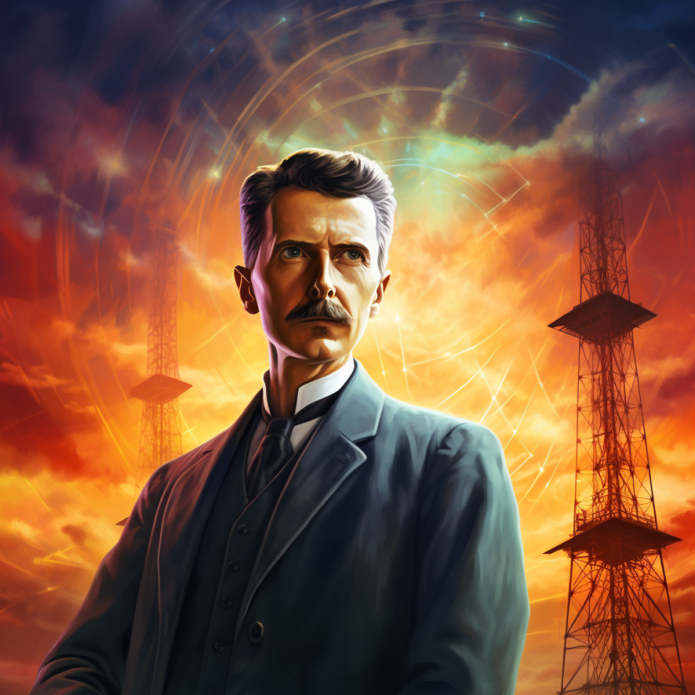
History of Wireless Transmissions
First to demonstrate wireless communication ?
1893: Nikola Tesla gave a public demonstration of "wireless" radio communication at St. Louis, Missouri, USA
Notes:
First, we look at the computational elements, and these consist of a microcontroller or an FPGA. Today, we find that these computational elements consume at least one order of magnitude higher power consumption when compared to the commonly used sensors.
However, we also find that microcontrollers are increasingly becoming energy efficient. We investigate a typical microcontroller that has been used in sensor platforms over the past two decades. We find that energy efficiency has improved by almost two orders of magnitude. Some of the present-generation microcontrollers, such as Ambiq Apollo4 consume just 3 uA/MHz than 330 uA for MSP430 used on platforms such as TelOS B.
If the trend continues, we can expect the microcontrollers to catch up with the sensors and become energy-efficient. This significant improvement is that the digital components are increasing becoming efficient as they follow moore’s law.

Slide 25
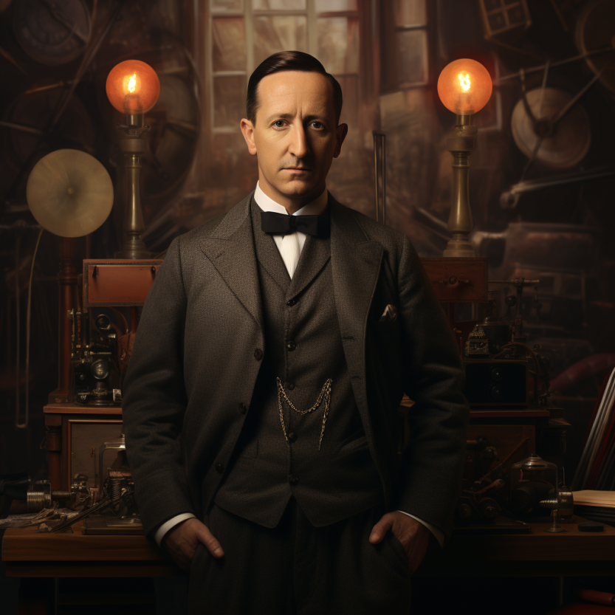
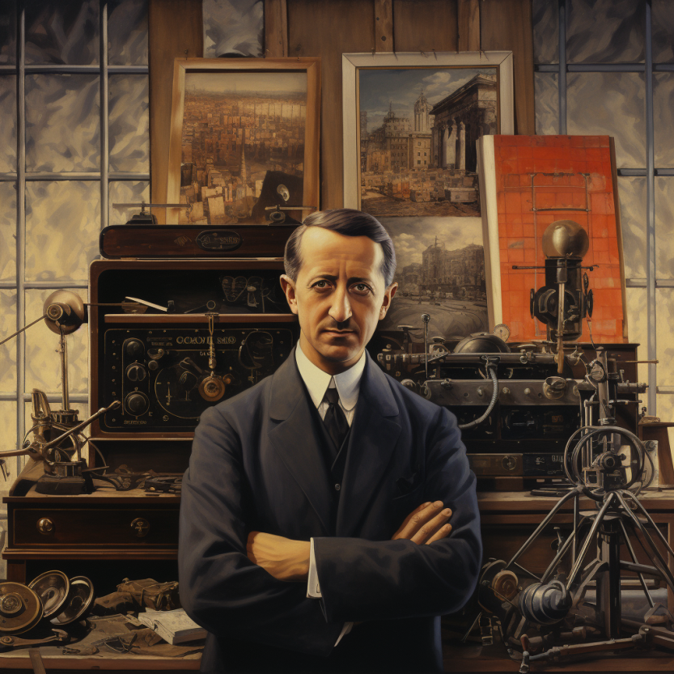
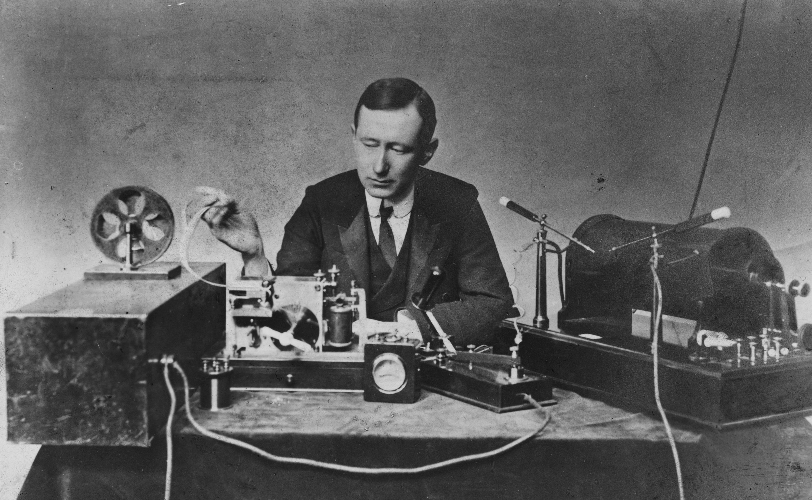
History of Wireless Transmissions
First to demonstrate wireless communication ?
1896: Guglielmo Marconi's first radio transmissions, coded signals that were transmitted only about 1.6 km (a mile)
1899: Marconi sends a signal over the English Channel ~50km
Notes:
First, we look at the computational elements, and these consist of a microcontroller or an FPGA. Today, we find that these computational elements consume at least one order of magnitude higher power consumption when compared to the commonly used sensors.
However, we also find that microcontrollers are increasingly becoming energy efficient. We investigate a typical microcontroller that has been used in sensor platforms over the past two decades. We find that energy efficiency has improved by almost two orders of magnitude. Some of the present-generation microcontrollers, such as Ambiq Apollo4 consume just 3 uA/MHz than 330 uA for MSP430 used on platforms such as TelOS B.
If the trend continues, we can expect the microcontrollers to catch up with the sensors and become energy-efficient. This significant improvement is that the digital components are increasing becoming efficient as they follow moore’s law.

Slide 26
Roadmap of the lecture today
General course information and updates
Let us review what we had covered in the last lecture
Terminology used: What is radio? Electromagnetic waves?
Basics of modulation and antennas
Signal propagation, estimating communication range
Notes:
Here is the roadmap of the major topics that I am going to cover during the presentation. We have already covered the exponential growth of the internet of things; next, I will talk about the critical energy challenge that can severely hinder this massive growth and preventing us from realising this immense economic value enabled by the IoT.

Slide 27
Terminology used in Wireless Networking
Notes:
++ Over the past few years, I have designed several backscatter and beyond backscatter systems that precisely overcome these critical challenges that have limited the widespread deployment of backscatter on IoT devices.
++ The research vision that I have pursued and would like to pursue as a faculty member is to enable a massive deployment of IoT devices by bridging the energy asymmetry between sensing, computation and communication blocks by designing novel platforms and communication mechanisms. I am going to describe some of my research contributions next.

Slide 28

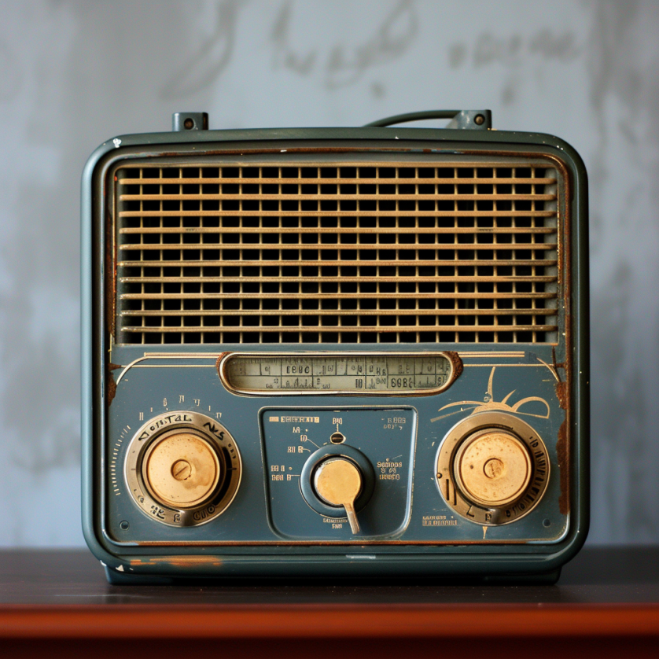
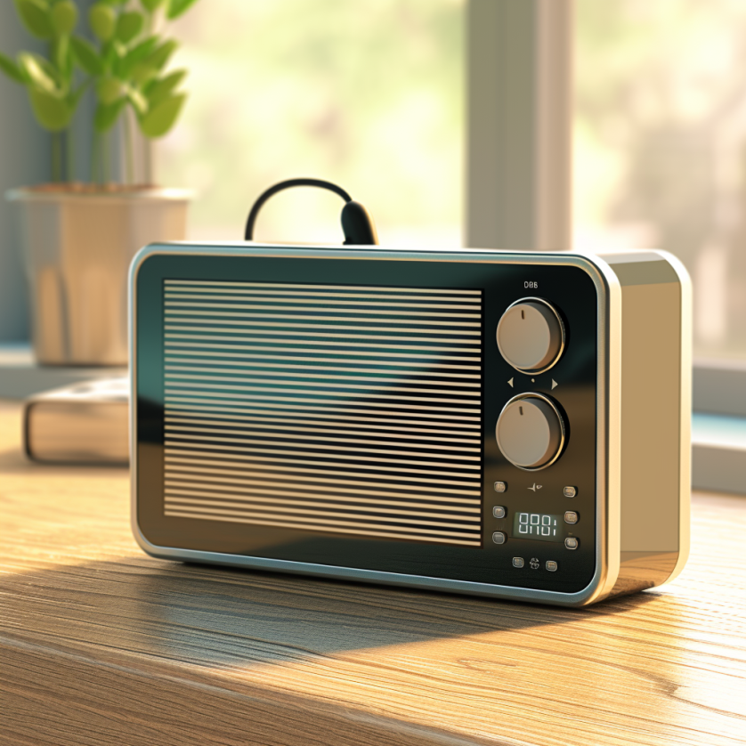
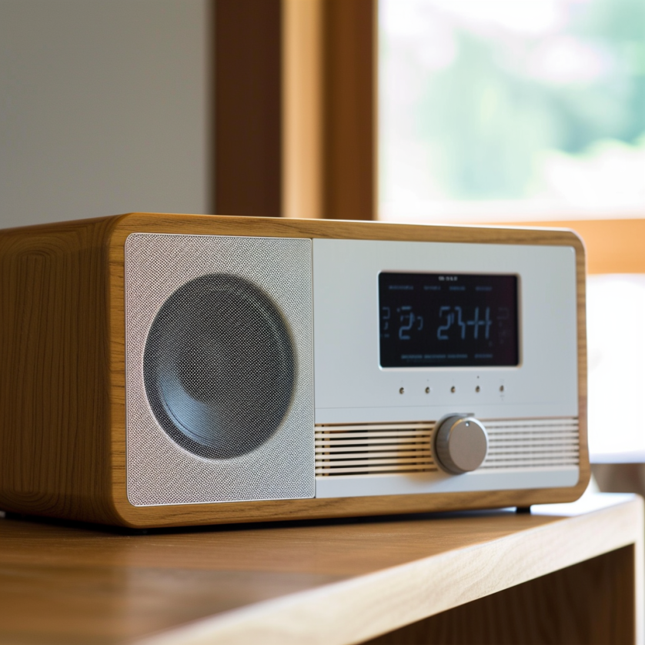
What does the term radio means?
Notes:
First, we look at the computational elements, and these consist of a microcontroller or an FPGA. Today, we find that these computational elements consume at least one order of magnitude higher power consumption when compared to the commonly used sensors.
However, we also find that microcontrollers are increasingly becoming energy efficient. We investigate a typical microcontroller that has been used in sensor platforms over the past two decades. We find that energy efficiency has improved by almost two orders of magnitude. Some of the present-generation microcontrollers, such as Ambiq Apollo4 consume just 3 uA/MHz than 330 uA for MSP430 used on platforms such as TelOS B.
If the trend continues, we can expect the microcontrollers to catch up with the sensors and become energy-efficient. This significant improvement is that the digital components are increasing becoming efficient as they follow moore’s law.

Slide 29
What does the term radio means?
The term radio originates from the Latin "radius," signifying "spoke of a wheel" or "ray of light." It was first used in communication context in 1881. French scientist Ernest Mercadier suggested the term, leading Alexander Graham Bell to name his photophone system "radiophone," which translates to "radiated sound."
Notes:
First, we look at the computational elements, and these consist of a microcontroller or an FPGA. Today, we find that these computational elements consume at least one order of magnitude higher power consumption when compared to the commonly used sensors.
However, we also find that microcontrollers are increasingly becoming energy efficient. We investigate a typical microcontroller that has been used in sensor platforms over the past two decades. We find that energy efficiency has improved by almost two orders of magnitude. Some of the present-generation microcontrollers, such as Ambiq Apollo4 consume just 3 uA/MHz than 330 uA for MSP430 used on platforms such as TelOS B.
If the trend continues, we can expect the microcontrollers to catch up with the sensors and become energy-efficient. This significant improvement is that the digital components are increasing becoming efficient as they follow moore’s law.

Slide 30
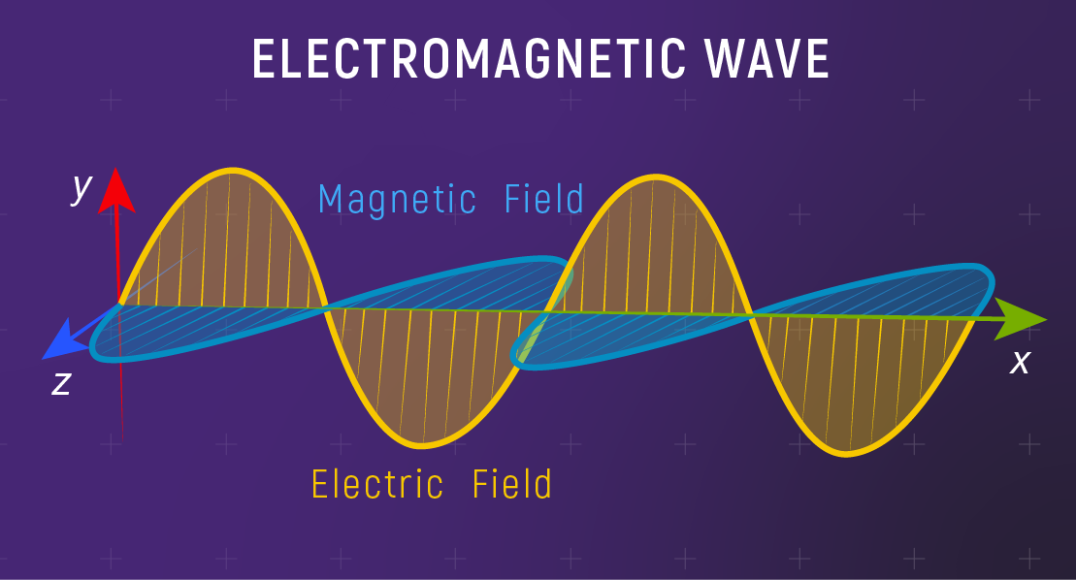
Fundamentals of electromagnetic waves
Electromagnetic (EM) waves are synchronized oscillations of electric and magnetic field. There is a periodic change of electric and magnetic field
How often this periodic change occurs dictates the property of EM waves
Notes:
First, we look at the computational elements, and these consist of a microcontroller or an FPGA. Today, we find that these computational elements consume at least one order of magnitude higher power consumption when compared to the commonly used sensors.
However, we also find that microcontrollers are increasingly becoming energy efficient. We investigate a typical microcontroller that has been used in sensor platforms over the past two decades. We find that energy efficiency has improved by almost two orders of magnitude. Some of the present-generation microcontrollers, such as Ambiq Apollo4 consume just 3 uA/MHz than 330 uA for MSP430 used on platforms such as TelOS B.
If the trend continues, we can expect the microcontrollers to catch up with the sensors and become energy-efficient. This significant improvement is that the digital components are increasing becoming efficient as they follow moore’s law.

Slide 31
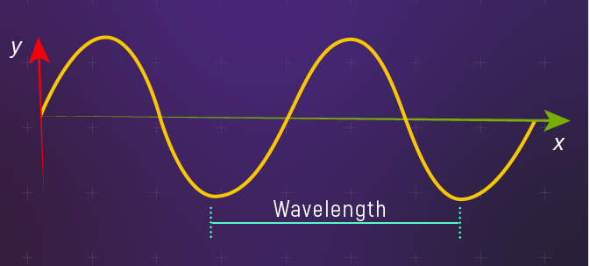
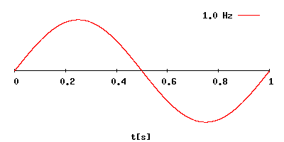
Fundamentals of electromagnetic waves
Electromagnetic (EM) waves are synchronized oscillations of electric and magnetic field. There is a periodic change of electric and magnetic field
How often this periodic change occurs dictates the property of EM waves
Changer period is termed as the frequency. The SI unit for frequency is Hertz (Hz)
1 Hz: one cycle of an electromagnetic wave in a second
Notes:
First, we look at the computational elements, and these consist of a microcontroller or an FPGA. Today, we find that these computational elements consume at least one order of magnitude higher power consumption when compared to the commonly used sensors.
However, we also find that microcontrollers are increasingly becoming energy efficient. We investigate a typical microcontroller that has been used in sensor platforms over the past two decades. We find that energy efficiency has improved by almost two orders of magnitude. Some of the present-generation microcontrollers, such as Ambiq Apollo4 consume just 3 uA/MHz than 330 uA for MSP430 used on platforms such as TelOS B.
If the trend continues, we can expect the microcontrollers to catch up with the sensors and become energy-efficient. This significant improvement is that the digital components are increasing becoming efficient as they follow moore’s law.

Slide 32
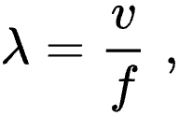
Wavelength of an electromagnetic wave
Wavelength of a sinusoidal waveform travelling at speed (v), frequency (f)
Electromagnetic waves that are travelling in free space, the speed is c or the speed of light. What is speed of light?
Notes:
First, we look at the computational elements, and these consist of a microcontroller or an FPGA. Today, we find that these computational elements consume at least one order of magnitude higher power consumption when compared to the commonly used sensors.
However, we also find that microcontrollers are increasingly becoming energy efficient. We investigate a typical microcontroller that has been used in sensor platforms over the past two decades. We find that energy efficiency has improved by almost two orders of magnitude. Some of the present-generation microcontrollers, such as Ambiq Apollo4 consume just 3 uA/MHz than 330 uA for MSP430 used on platforms such as TelOS B.
If the trend continues, we can expect the microcontrollers to catch up with the sensors and become energy-efficient. This significant improvement is that the digital components are increasing becoming efficient as they follow moore’s law.

Slide 33
Wavelength of an electromagnetic wave
Wavelength of a sinusoidal waveform travelling at speed (v), frequency (f)
Electromagnetic waves that are travelling in free space, the speed is c or the speed of light. What is speed of light? 3×10⁸ m/s
Different color of light, different wavelength!
Notes:
First, we look at the computational elements, and these consist of a microcontroller or an FPGA. Today, we find that these computational elements consume at least one order of magnitude higher power consumption when compared to the commonly used sensors.
However, we also find that microcontrollers are increasingly becoming energy efficient. We investigate a typical microcontroller that has been used in sensor platforms over the past two decades. We find that energy efficiency has improved by almost two orders of magnitude. Some of the present-generation microcontrollers, such as Ambiq Apollo4 consume just 3 uA/MHz than 330 uA for MSP430 used on platforms such as TelOS B.
If the trend continues, we can expect the microcontrollers to catch up with the sensors and become energy-efficient. This significant improvement is that the digital components are increasing becoming efficient as they follow moore’s law.

Slide 34
What does the term radio mean?
Radio technology implies the task of transmission and reception of information using electromagnetic waves of frequency 3 Hz to 300 GHz. Electromagnetic waves at these frequencies are also called radio waves, and the frequency bands are called radio spectrum.
Notes:
First, we look at the computational elements, and these consist of a microcontroller or an FPGA. Today, we find that these computational elements consume at least one order of magnitude higher power consumption when compared to the commonly used sensors.
However, we also find that microcontrollers are increasingly becoming energy efficient. We investigate a typical microcontroller that has been used in sensor platforms over the past two decades. We find that energy efficiency has improved by almost two orders of magnitude. Some of the present-generation microcontrollers, such as Ambiq Apollo4 consume just 3 uA/MHz than 330 uA for MSP430 used on platforms such as TelOS B.
If the trend continues, we can expect the microcontrollers to catch up with the sensors and become energy-efficient. This significant improvement is that the digital components are increasing becoming efficient as they follow moore’s law.

Slide 35
What does the term radio mean?
Radio technology implies the task of transmission and reception of information using electromagnetic waves of frequency 3 Hz to 300 GHz. Electromagnetic waves at these frequencies are also called radio waves, and the frequency bands are called radio spectrum.
What is wavelength for frequency of 3Hz?
Notes:
First, we look at the computational elements, and these consist of a microcontroller or an FPGA. Today, we find that these computational elements consume at least one order of magnitude higher power consumption when compared to the commonly used sensors.
However, we also find that microcontrollers are increasingly becoming energy efficient. We investigate a typical microcontroller that has been used in sensor platforms over the past two decades. We find that energy efficiency has improved by almost two orders of magnitude. Some of the present-generation microcontrollers, such as Ambiq Apollo4 consume just 3 uA/MHz than 330 uA for MSP430 used on platforms such as TelOS B.
If the trend continues, we can expect the microcontrollers to catch up with the sensors and become energy-efficient. This significant improvement is that the digital components are increasing becoming efficient as they follow moore’s law.

Slide 36


What does the term radio mean?
Radio technology implies the task of transmission and reception of information using electromagnetic waves of frequency 3 Hz to 300 GHz. Electromagnetic waves at these frequencies are also called radio waves, and the frequency bands are called radio spectrum.
What is wavelength for frequency of 3Hz? (approx.) 100 Kilometer!
Distance between London and Oxford
Notes:
First, we look at the computational elements, and these consist of a microcontroller or an FPGA. Today, we find that these computational elements consume at least one order of magnitude higher power consumption when compared to the commonly used sensors.
However, we also find that microcontrollers are increasingly becoming energy efficient. We investigate a typical microcontroller that has been used in sensor platforms over the past two decades. We find that energy efficiency has improved by almost two orders of magnitude. Some of the present-generation microcontrollers, such as Ambiq Apollo4 consume just 3 uA/MHz than 330 uA for MSP430 used on platforms such as TelOS B.
If the trend continues, we can expect the microcontrollers to catch up with the sensors and become energy-efficient. This significant improvement is that the digital components are increasing becoming efficient as they follow moore’s law.

Slide 37
What does the term radio mean?
Radio technology implies the task of transmission and reception of information using electromagnetic waves of frequency 3 Hz to 300 GHz. Electromagnetic waves at these frequencies are also called radio waves, and the frequency bands are called radio spectrum.
What is wavelength of 100 MHz (FM Band) ?
Notes:
First, we look at the computational elements, and these consist of a microcontroller or an FPGA. Today, we find that these computational elements consume at least one order of magnitude higher power consumption when compared to the commonly used sensors.
However, we also find that microcontrollers are increasingly becoming energy efficient. We investigate a typical microcontroller that has been used in sensor platforms over the past two decades. We find that energy efficiency has improved by almost two orders of magnitude. Some of the present-generation microcontrollers, such as Ambiq Apollo4 consume just 3 uA/MHz than 330 uA for MSP430 used on platforms such as TelOS B.
If the trend continues, we can expect the microcontrollers to catch up with the sensors and become energy-efficient. This significant improvement is that the digital components are increasing becoming efficient as they follow moore’s law.

Slide 38


What does the term radio mean?
Radio technology implies the task of transmission and reception of information using electromagnetic waves of frequency 3 Hz to 300 GHz. Electromagnetic waves at these frequencies are also called radio waves, and the frequency bands are called radio spectrum.
What is wavelength of 100 MHz (FM Band) ? 3 Meters
Notes:
First, we look at the computational elements, and these consist of a microcontroller or an FPGA. Today, we find that these computational elements consume at least one order of magnitude higher power consumption when compared to the commonly used sensors.
However, we also find that microcontrollers are increasingly becoming energy efficient. We investigate a typical microcontroller that has been used in sensor platforms over the past two decades. We find that energy efficiency has improved by almost two orders of magnitude. Some of the present-generation microcontrollers, such as Ambiq Apollo4 consume just 3 uA/MHz than 330 uA for MSP430 used on platforms such as TelOS B.
If the trend continues, we can expect the microcontrollers to catch up with the sensors and become energy-efficient. This significant improvement is that the digital components are increasing becoming efficient as they follow moore’s law.

Slide 39
What does the term radio mean?
Radio technology implies the task of transmission and reception of information using electromagnetic waves of frequency 3 Hz to 300 GHz. Electromagnetic waves at these frequencies are also called radio waves, and the frequency bands are called radio spectrum.
What is wavelength of 100 GHz?
Notes:
First, we look at the computational elements, and these consist of a microcontroller or an FPGA. Today, we find that these computational elements consume at least one order of magnitude higher power consumption when compared to the commonly used sensors.
However, we also find that microcontrollers are increasingly becoming energy efficient. We investigate a typical microcontroller that has been used in sensor platforms over the past two decades. We find that energy efficiency has improved by almost two orders of magnitude. Some of the present-generation microcontrollers, such as Ambiq Apollo4 consume just 3 uA/MHz than 330 uA for MSP430 used on platforms such as TelOS B.
If the trend continues, we can expect the microcontrollers to catch up with the sensors and become energy-efficient. This significant improvement is that the digital components are increasing becoming efficient as they follow moore’s law.

Slide 40


What does the term radio mean?
Radio technology implies the task of transmission and reception of information using electromagnetic waves of frequency 3 Hz to 300 GHz. Electromagnetic waves at these frequencies are also called radio waves, and the frequency bands are called radio spectrum.
What is wavelength of 100 GHz? 0.3 centimeter
Notes:
First, we look at the computational elements, and these consist of a microcontroller or an FPGA. Today, we find that these computational elements consume at least one order of magnitude higher power consumption when compared to the commonly used sensors.
However, we also find that microcontrollers are increasingly becoming energy efficient. We investigate a typical microcontroller that has been used in sensor platforms over the past two decades. We find that energy efficiency has improved by almost two orders of magnitude. Some of the present-generation microcontrollers, such as Ambiq Apollo4 consume just 3 uA/MHz than 330 uA for MSP430 used on platforms such as TelOS B.
If the trend continues, we can expect the microcontrollers to catch up with the sensors and become energy-efficient. This significant improvement is that the digital components are increasing becoming efficient as they follow moore’s law.

Slide 41
What are radio transceivers?
Radio transceivers are components that enables the transmission and reception of electromagnetic waves. A key component in wireless device
Antenna
Radio frequency signal
Transmitting
Device
Receiving Device
Notes:
First, we look at the computational elements, and these consist of a microcontroller or an FPGA. Today, we find that these computational elements consume at least one order of magnitude higher power consumption when compared to the commonly used sensors.
However, we also find that microcontrollers are increasingly becoming energy efficient. We investigate a typical microcontroller that has been used in sensor platforms over the past two decades. We find that energy efficiency has improved by almost two orders of magnitude. Some of the present-generation microcontrollers, such as Ambiq Apollo4 consume just 3 uA/MHz than 330 uA for MSP430 used on platforms such as TelOS B.
If the trend continues, we can expect the microcontrollers to catch up with the sensors and become energy-efficient. This significant improvement is that the digital components are increasing becoming efficient as they follow moore’s law.

Slide 42
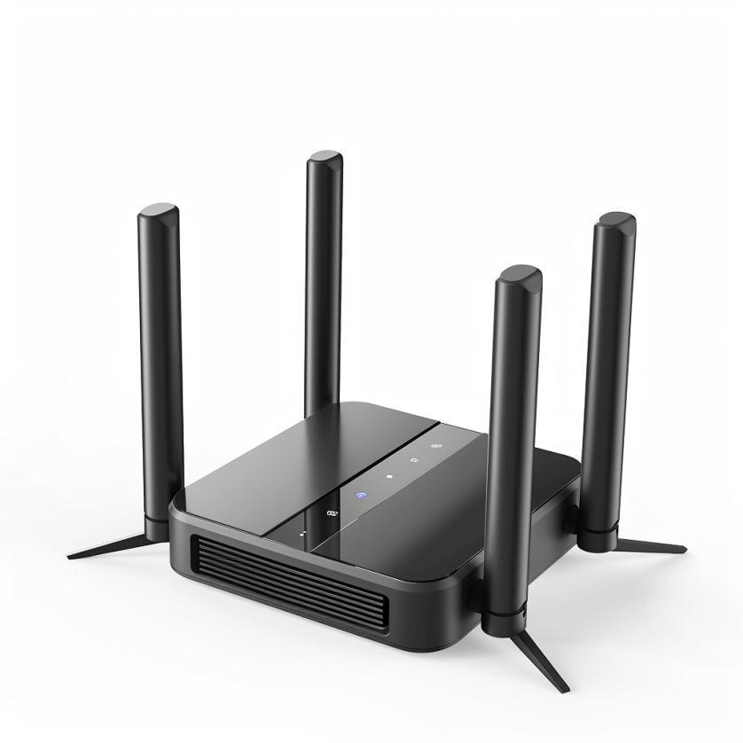

Radio transceivers in devices: WiFi
Notes:
First, we look at the computational elements, and these consist of a microcontroller or an FPGA. Today, we find that these computational elements consume at least one order of magnitude higher power consumption when compared to the commonly used sensors.
However, we also find that microcontrollers are increasingly becoming energy efficient. We investigate a typical microcontroller that has been used in sensor platforms over the past two decades. We find that energy efficiency has improved by almost two orders of magnitude. Some of the present-generation microcontrollers, such as Ambiq Apollo4 consume just 3 uA/MHz than 330 uA for MSP430 used on platforms such as TelOS B.
If the trend continues, we can expect the microcontrollers to catch up with the sensors and become energy-efficient. This significant improvement is that the digital components are increasing becoming efficient as they follow moore’s law.

Slide 43
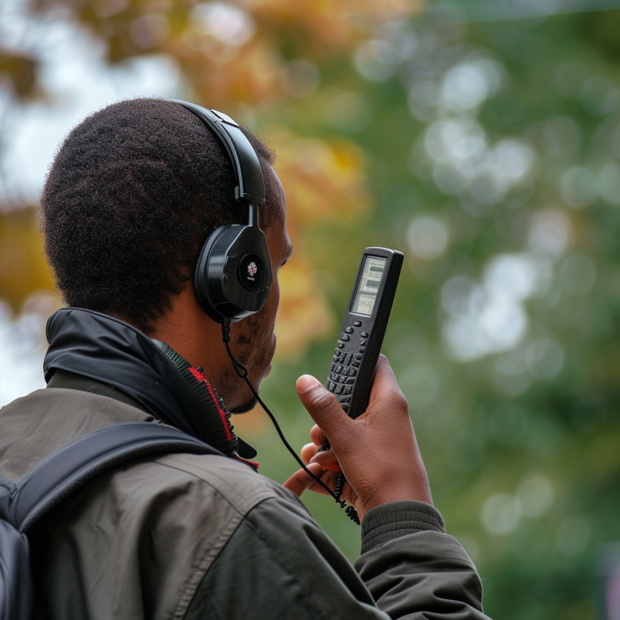
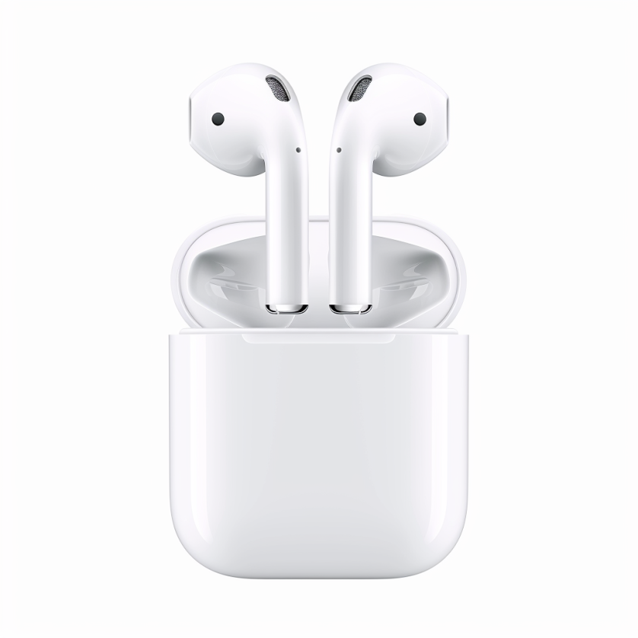
Radio transceivers in devices: Bluetooth, Walkie-Talkie
Notes:
First, we look at the computational elements, and these consist of a microcontroller or an FPGA. Today, we find that these computational elements consume at least one order of magnitude higher power consumption when compared to the commonly used sensors.
However, we also find that microcontrollers are increasingly becoming energy efficient. We investigate a typical microcontroller that has been used in sensor platforms over the past two decades. We find that energy efficiency has improved by almost two orders of magnitude. Some of the present-generation microcontrollers, such as Ambiq Apollo4 consume just 3 uA/MHz than 330 uA for MSP430 used on platforms such as TelOS B.
If the trend continues, we can expect the microcontrollers to catch up with the sensors and become energy-efficient. This significant improvement is that the digital components are increasing becoming efficient as they follow moore’s law.

Slide 44


What do you mean by spectrum? Radio spectrum?
In the 17th century, Isaac Newton introduced the concept of the spectrum to the field of physical sciences, specifically in optics. He used this term to describe the array of colors visible when white light passed through a prism and was separated into its constituent hues. Later the term was expanded to include other waves, including radio waves.
Notes:
First, we look at the computational elements, and these consist of a microcontroller or an FPGA. Today, we find that these computational elements consume at least one order of magnitude higher power consumption when compared to the commonly used sensors.
However, we also find that microcontrollers are increasingly becoming energy efficient. We investigate a typical microcontroller that has been used in sensor platforms over the past two decades. We find that energy efficiency has improved by almost two orders of magnitude. Some of the present-generation microcontrollers, such as Ambiq Apollo4 consume just 3 uA/MHz than 330 uA for MSP430 used on platforms such as TelOS B.
If the trend continues, we can expect the microcontrollers to catch up with the sensors and become energy-efficient. This significant improvement is that the digital components are increasing becoming efficient as they follow moore’s law.

Slide 45


Radio waves most important part of EM spectrum
Notes:
First, we look at the computational elements, and these consist of a microcontroller or an FPGA. Today, we find that these computational elements consume at least one order of magnitude higher power consumption when compared to the commonly used sensors.
However, we also find that microcontrollers are increasingly becoming energy efficient. We investigate a typical microcontroller that has been used in sensor platforms over the past two decades. We find that energy efficiency has improved by almost two orders of magnitude. Some of the present-generation microcontrollers, such as Ambiq Apollo4 consume just 3 uA/MHz than 330 uA for MSP430 used on platforms such as TelOS B.
If the trend continues, we can expect the microcontrollers to catch up with the sensors and become energy-efficient. This significant improvement is that the digital components are increasing becoming efficient as they follow moore’s law.

Slide 46
Break! (5 minutes)
Notes:
++ Over the past few years, I have designed several backscatter and beyond backscatter systems that precisely overcome these critical challenges that have limited the widespread deployment of backscatter on IoT devices.
++ The research vision that I have pursued and would like to pursue as a faculty member is to enable a massive deployment of IoT devices by bridging the energy asymmetry between sensing, computation and communication blocks by designing novel platforms and communication mechanisms. I am going to describe some of my research contributions next.

Slide 47
Roadmap of the lecture today
General course information and updates
Let us review what we had covered in the last lecture
Terminology used: What is radio? Electromagnetic waves?
Basics of modulation and antennas
Estimating communication range
Notes:
Here is the roadmap of the major topics that I am going to cover during the presentation. We have already covered the exponential growth of the internet of things; next, I will talk about the critical energy challenge that can severely hinder this massive growth and preventing us from realising this immense economic value enabled by the IoT.

Slide 48
How are radio waves characterized?
Radio waves can be characterized based on following parameters:
Strength/Power: energy contained in the radio wave
Frequency: rate of periodic variation between electric and magnetic field
Bandwidth: range of frequencies of radio waves present in the transmission
Polarization: orientation of electric field. May be circular, elliptical or linear
Modulation: variation of waves property to encode information
Notes:
First, we look at the computational elements, and these consist of a microcontroller or an FPGA. Today, we find that these computational elements consume at least one order of magnitude higher power consumption when compared to the commonly used sensors.
However, we also find that microcontrollers are increasingly becoming energy efficient. We investigate a typical microcontroller that has been used in sensor platforms over the past two decades. We find that energy efficiency has improved by almost two orders of magnitude. Some of the present-generation microcontrollers, such as Ambiq Apollo4 consume just 3 uA/MHz than 330 uA for MSP430 used on platforms such as TelOS B.
If the trend continues, we can expect the microcontrollers to catch up with the sensors and become energy-efficient. This significant improvement is that the digital components are increasing becoming efficient as they follow moore’s law.

Slide 49



How are radio waves modified to carry information
Encoding information “baseband" in an analog “carrier” signal
Baseband signal often much lower in frequency than the carrier
Frequency of the carrier signal dictates the part of the radio spectrum
Why? baseband signals or information change is at much lower rate
Speech: upto 20 KHz, temperature changes – few Hz
Enables a better usage of the radio spectrum
Enables communication among several devices sharing the spectrum
Modulation
Notes:
First, we look at the computational elements, and these consist of a microcontroller or an FPGA. Today, we find that these computational elements consume at least one order of magnitude higher power consumption when compared to the commonly used sensors.
However, we also find that microcontrollers are increasingly becoming energy efficient. We investigate a typical microcontroller that has been used in sensor platforms over the past two decades. We find that energy efficiency has improved by almost two orders of magnitude. Some of the present-generation microcontrollers, such as Ambiq Apollo4 consume just 3 uA/MHz than 330 uA for MSP430 used on platforms such as TelOS B.
If the trend continues, we can expect the microcontrollers to catch up with the sensors and become energy-efficient. This significant improvement is that the digital components are increasing becoming efficient as they follow moore’s law.

Slide 50
What are different modulation techniques?
Vary frequency, amplitude, phase of carrier signal according message signal
We can also vary them together to support complex modulation schemes
Analog and Digital counterparts of these modulation schemes exist
Modulation
Notes:
First, we look at the computational elements, and these consist of a microcontroller or an FPGA. Today, we find that these computational elements consume at least one order of magnitude higher power consumption when compared to the commonly used sensors.
However, we also find that microcontrollers are increasingly becoming energy efficient. We investigate a typical microcontroller that has been used in sensor platforms over the past two decades. We find that energy efficiency has improved by almost two orders of magnitude. Some of the present-generation microcontrollers, such as Ambiq Apollo4 consume just 3 uA/MHz than 330 uA for MSP430 used on platforms such as TelOS B.
If the trend continues, we can expect the microcontrollers to catch up with the sensors and become energy-efficient. This significant improvement is that the digital components are increasing becoming efficient as they follow moore’s law.

Slide 51

Amplitude modulation: vary amplitude of carrier signal
Change amplitude of a carrier signal according to the message signal
Simplest and the earliest introduced modulation technique
Remains widely used for radio broadcast, also computer communication
Disadvantage: signal prone to interference, less bandwidth efficient
Notes:
First, we look at the computational elements, and these consist of a microcontroller or an FPGA. Today, we find that these computational elements consume at least one order of magnitude higher power consumption when compared to the commonly used sensors.
However, we also find that microcontrollers are increasingly becoming energy efficient. We investigate a typical microcontroller that has been used in sensor platforms over the past two decades. We find that energy efficiency has improved by almost two orders of magnitude. Some of the present-generation microcontrollers, such as Ambiq Apollo4 consume just 3 uA/MHz than 330 uA for MSP430 used on platforms such as TelOS B.
If the trend continues, we can expect the microcontrollers to catch up with the sensors and become energy-efficient. This significant improvement is that the digital components are increasing becoming efficient as they follow moore’s law.

Slide 52

Frequency modulation: vary frequency of carrier signal
Change frequency of a carrier signal according to the message signal
Advantages (over AM): Resilient to interference, spectrum efficiency
Remains widely used for radio broadcast, also computer communication
First demonstrated by Armstrong in 1935!
Notes:
First, we look at the computational elements, and these consist of a microcontroller or an FPGA. Today, we find that these computational elements consume at least one order of magnitude higher power consumption when compared to the commonly used sensors.
However, we also find that microcontrollers are increasingly becoming energy efficient. We investigate a typical microcontroller that has been used in sensor platforms over the past two decades. We find that energy efficiency has improved by almost two orders of magnitude. Some of the present-generation microcontrollers, such as Ambiq Apollo4 consume just 3 uA/MHz than 330 uA for MSP430 used on platforms such as TelOS B.
If the trend continues, we can expect the microcontrollers to catch up with the sensors and become energy-efficient. This significant improvement is that the digital components are increasing becoming efficient as they follow moore’s law.

Slide 53


Phase modulation: vary phase of carrier signal
Change phase of a carrier signal according to the message signal
It is an integral part of modern communication standards: WiFi, Television
Advantages (over FM): Better SNR, spectral efficiency
Notes:
First, we look at the computational elements, and these consist of a microcontroller or an FPGA. Today, we find that these computational elements consume at least one order of magnitude higher power consumption when compared to the commonly used sensors.
However, we also find that microcontrollers are increasingly becoming energy efficient. We investigate a typical microcontroller that has been used in sensor platforms over the past two decades. We find that energy efficiency has improved by almost two orders of magnitude. Some of the present-generation microcontrollers, such as Ambiq Apollo4 consume just 3 uA/MHz than 330 uA for MSP430 used on platforms such as TelOS B.
If the trend continues, we can expect the microcontrollers to catch up with the sensors and become energy-efficient. This significant improvement is that the digital components are increasing becoming efficient as they follow moore’s law.

Slide 54

Digital equivalent of the AM, FM and PM modulation
Digital variant of these schemes vary analog signal according to digital bits
ASK: amplitude shift keying
FSK: frequency shift keying
PSK: phase shift keying
Digital variants relevant when we talk about computer communication
Notes:
First, we look at the computational elements, and these consist of a microcontroller or an FPGA. Today, we find that these computational elements consume at least one order of magnitude higher power consumption when compared to the commonly used sensors.
However, we also find that microcontrollers are increasingly becoming energy efficient. We investigate a typical microcontroller that has been used in sensor platforms over the past two decades. We find that energy efficiency has improved by almost two orders of magnitude. Some of the present-generation microcontrollers, such as Ambiq Apollo4 consume just 3 uA/MHz than 330 uA for MSP430 used on platforms such as TelOS B.
If the trend continues, we can expect the microcontrollers to catch up with the sensors and become energy-efficient. This significant improvement is that the digital components are increasing becoming efficient as they follow moore’s law.

Slide 55

Even more complex modulation schemes exist
Builds on simple modulation schemes AM, FM, PM (or digital equivalent)
Briefly cover some during later part of the course
Complex modulation schemes ensure better performance
Spectral efficiency
Higher range
Higher throughput
……
Choice of the modulation scheme depends on the target application
Notes:
First, we look at the computational elements, and these consist of a microcontroller or an FPGA. Today, we find that these computational elements consume at least one order of magnitude higher power consumption when compared to the commonly used sensors.
However, we also find that microcontrollers are increasingly becoming energy efficient. We investigate a typical microcontroller that has been used in sensor platforms over the past two decades. We find that energy efficiency has improved by almost two orders of magnitude. Some of the present-generation microcontrollers, such as Ambiq Apollo4 consume just 3 uA/MHz than 330 uA for MSP430 used on platforms such as TelOS B.
If the trend continues, we can expect the microcontrollers to catch up with the sensors and become energy-efficient. This significant improvement is that the digital components are increasing becoming efficient as they follow moore’s law.

Slide 56
How radio waves propagate to the receiver
Antenna
Radio frequency signal
Transmitting
Device
Receiving Device

Slide 57

How radio waves radiate out from transceiver
Antenna: An electrical conductor or system of conductors
Transmission: radio frequency electrical energy converted into electromagnetic energy
Reception: the reverse occurs, electromagnetic energy converted into electrical energy
Antennas can be categorized intro directional or omnidirectional
Based on the radiation pattern of the antenna

Slide 58




Common antenna types used for communication
Monopole: A straight wire mounted on conductive surface (ground plane)
Array: A set of connected antenna elements working together
Loop: A loop or wire or a conductor that acts like an antenna
Aperture: Transmits/receives electromagnetic wave through a hole
….. (and even more exists) …..

Slide 59


Dipole antenna types used for communication
Dipole antenna: A simple antenna consisting of wires pointed in opposite directions arranged either horizontally or vertically, with end of each wire connected to the radio and the other end is hanging in the free space
Half-wave dipole: A more efficient variation of dipole antenna is the half-wave dipole antenna, which radiates energy efficiently when the wavelength of radio signal is twice the electrical length of the antenna

Slide 60

Relationship between antenna size and frequency
Antenna size is inversely proportional to the frequency of radio wave
Higher the frequency, smaller the antenna size
Lower frequency, larger is the antenna size
For example:
Dipole: Length of the conductor is half of the wave length of radio wave
Half-wave dipole: Length of conductor is quarter wavelength of radio wave

Slide 61
Understanding the performance of an antenna
Gain of antenna: It is a dimensionless quantity that measures the ability of an antenna to direct or receive radio waves in a particular direction compared to a reference. It is usually measured in the unit of decibel (dB)
Often measured in reference to hypothetical isotropic antenna (dBi)
Can be measured in reference to a halfwave dipole antenna (dBd)
Antennas are reciprocal in nature. Transmit and receive equally well
Tradeoffs: Higher the gain, more directional is the transmission and reception, and the narrower would be the beam

Slide 62
Understanding the performance of an antenna
Power output, in a particular direction, compared to that produced in any direction by a perfect omni-directional antenna (isotropic antenna)‏
Effective area: related to physical size and shape of antenna
Relationship between antenna gain and effective area
G = antenna gain
A_{e} = effective area
f = carrier frequency
c = speed of light 3 X 10⁸ m/s
Lambda = carrier wavelength

Slide 63
Roadmap of the lecture today
General course information and updates
Let us review what we had covered in the last lecture
Terminology used: What is radio? Electromagnetic waves?
Basics of modulation and antennas
Signal propagation, estimating communication range
Notes:
Here is the roadmap of the major topics that I am going to cover during the presentation. We have already covered the exponential growth of the internet of things; next, I will talk about the critical energy challenge that can severely hinder this massive growth and preventing us from realising this immense economic value enabled by the IoT.

Slide 64


How do radio waves propagate from TX to RX?
Medium and environment has an important role to play in propagation
Radio waves do not propagate well underwater. Submarines uses sound
Environment impacts the radio wave propagation significantly
Reduced communication range
Interference from other devices
Issues with reliability
…… and many more

Slide 65
Radio propagation is complex in real-world, especially when obstacles are present

Slide 66

Radio propagation is complex in real-world, especially when obstacles are present
Reflection
e.g. earth surface, buildings
Diffraction
Radio wave bends around the obstacle
Scattering
Obstacles smaller than wavelength of wave (e.g. foliage)
Signal is scattered into several weaker signals

Slide 67

Radio waves propagation in line-of-sight
Transmitting and receiving antennas must be within line of sight
Satellite communication – signal above 30 MHz not reflected by ionosphere
Ground communication – antennas in effective line of site due to refraction

Slide 68

Long range wireless transmissions using IoT devices

Slide 69


Non-line of sight propagation of radio waves
Transmitter and receiver are not kept in line of sight
Radio waves encounter obstacles, may go through walls, buildings
Much more applicable to read world environment and deployments
Significantly impacts the communication range and reliability

Slide 70
Estimating received signal strength and range: Friis propagation model
f_{c} is the center frequency in Hz
c is speed of light
d is the distance between transmitter and receiver
Alpha is the path loss component
G is antenna gain

Slide 71
Estimating received signal strength and range: Friis propagation model
Path Loss in dB
Also simplifies to
d

Slide 72
Path Loss Exponent
Environment
Path Loss Exponential (α)
Free Space
2
Urban area cellualr radio
2.7 to 3.5
Shadowed urban cellular radio
3 to 5
In building LOS
1.6 to 1.8
Obstructed in building
4 to 6
Obstructed in factory
2 to 3
Rapport, Table 4.2, pp139

Slide 73
Example: Range and antenna gain estimation
Question: A wireless receiver with an effective radius of 100cm is receiving signals at 2 GHz from a transmitter that transmits at a power of 100W and a gain of 40dB (or 10,000). Assume path loss exponent is 2.
What is the gain of the receiver antenna?
What is the received power if the receiver is 1km away from the transmitter?
If the receiver is receiving signals at 900 MHz frequency (instead of 2GHz), please calculate (a) and (b) again?
What do you notice and why?

Slide 74
Example: Range and antenna gain estimation
Question: A wireless receiver with an effective radius of 100cm is receiving signals at 2 GHz from a transmitter that transmits at a power of 100W and a gain of 40dB (or 10,000). Assume path loss exponent is 2.
What is the gain of the receiver antenna?
What is the received power if the receiver is 1km away from the transmitter?
If the receiver is receiving signals at 900 MHz frequency (instead of 2GHz), please calculate (a) and (b) again?
What do you notice and why?

Slide 75

Example: Range and antenna gain estimation

Slide 76

Example: Range and antenna gain estimation

Slide 77
Example: Range and antenna gain estimation
The antenna gain decreases at lower frequencies (if the remaining factors are kept constant). Second, despite lower antenna gain due to higher frequencies, better propagation characteristics mean that the received signal power remains similar to one we had calculated at a higher frequency. Lower frequencies have better propagation characteristics.

Slide 78
Roadmap of the lecture today
General course information and updates
Let us review what we had covered in the last lecture
Terminology used: What is radio? Electromagnetic waves?
Basics of modulation and antennas
Signal propagation, estimating communication range
Notes:
Here is the roadmap of the major topics that I am going to cover during the presentation. We have already covered the exponential growth of the internet of things; next, I will talk about the critical energy challenge that can severely hinder this massive growth and preventing us from realising this immense economic value enabled by the IoT.

Slide 79
Todos and next week
Review today’s lecture and the prepare for tutorial next week
Review reading list presented on the course webpage
Start discussions regarding formation of group for assignments/projects
Next week: We cover the range estimation, Sensing, Actuation and Contiki
Notes:
++ We may all have heard of the term Internet of Things. So how are these wireless embedded systems related to the Internet of Things: Today, IoT includes a broad class of devices, including powerful platforms such as smartphones. However, it also includes more resource-constrained devices and what we call Wireless Embedded Systems, and in fact, I consider it to be one of the essential parts of the IoT ecosystem.
++ These are platforms equipped with a radio transceiver, sensor, microcontroller, and some form of energy storage. These platforms also often form a network, and sensor network as it is called has been an active area of research for the past two decades.
++ The research community has also developed wireless embedded platforms which we may know about, and these include: CMUCAM, which is an image sensor platform developed at Carnegie Mellon University, or Permamote is long life sensor platform from the lab I am associated with at UC Berkeley or Lorea which is a long-range backscatter platform that I had developed as part of my doctoral dissertation at Uppsala University. All of these are an example of Wireless Embedded Systems.

Slide 80
Wireless Networking
Ambuj Varshney
ambujv@nus.edu.sg
Notes:
++ Thank you for inviting me to give this talk
++ In this talk, I will present a pathway that can enable us to make wireless embedded systems ubiquitous. I will describe my previous research efforts that tackle the critical challenges that limit the growth of wireless embedded systems. These are related to the growing energy asymmetry that exists between sensing, computation and communication blocks on these platforms.
++ Finally, I will conclude my talk by covering the research agenda that I would like to work on as a faculty member.

